Slide 1
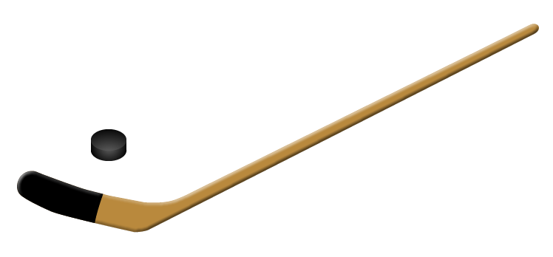
StrathroyDistrictMinorHockeyAssociation
2020 – 2021 Season
New Member Orientation

Slide 2
S.D.M.H.A
Mission Statement
Provide a fun, safe and positive experience that encourages our kids to develop as hockey players, grow as individuals and gain experience
in a team environment
Provide an atmosphere that helps build confidence in our players
Listen for the laughter and make it fun...it’s a great game
Always teach fair play and good sportsmanship
Yes…you can make a positive difference

Slide 3
S.D.M.H.A
Equipment List for all Divisions (U6 – U18)
Jock (male) - Fitted according to waist size
Jill (female) - Fitted according to waist size
Shin Pads - Must cover entire kneecap area, front and side
Pants - Must protect front and side of thigh, tail bone, hip & kidney area
Shoulder Pads - Must protect shoulder joint, collar bone, chest, back, and upper arm
Elbow Pads - Must protect entire elbow, parts of upper arm and forearm
Helmet - Must be CSA approved with unexpired date
Facemask - Must be CSA approved
Gloves - Should be snug, palms pliable so the player can grip the stick easily
Skates - Must be sharpened, blade covers are recommended
Neck Guards - Must bear the BNQ certification logo
Mouth Guards - Shock Doctor or sized and fitted by your Dentist
Sticks - Should reach between the chin and mouth of the player in street shoes
Hockey Socks - Provided by Tim Horton’s
Hockey Sweaters - Provided by Tim Horton’s (Player can keep at end of season)
THANK YOU TIM HORTON’S for SPONSORING U6 & U7!

Slide 4
S.D.M.H.A
General Association Information
Member of Ontario Minor Hockey Association
SDMHA is a “BB” Centre
Registration for each season is approximately 450 players
We ice teams from U6 (formerly PreSchool) to U18 (formerly Midget)
Teams compete at the “Rep”, “AE” and Local League levels

Slide 5
S.D.M.H.A
General Association Information
Rep and AE teams play in the Shamrock League
Local League teams play in the Lambton Middlesex League
Our “AAA” Centre is the Elgin-Middlesex Chiefs
SDMHA’s annual operating budget is approximately $450k
SDMHA hosts 3 Annual Tournaments - Rep/AE Olympics, John Henry LL Tournament and a Jr. Rockets Jamboree

Slide 6
S.D.M.H.A
General Association Information
While all teams are designed to be competitive, Rep teams represent the highest level of play within any division of the SDMHA
Players in U11 and above may choose to try out for the Rep team
If not successful at making the Rep cut, players will automatically be eligible to try out for the AE team in the same division
If not successful at making the AE team, players will be assigned to a Local League team
It is not a requirement to try out when registering for minor hockey. Players may wish to play Local League only.

Slide 7
S.D.M.H.A
General Association Information – Cash Calendar & Volunteer Fee
Our only fundraiser is a mandatory Cash Calendar which is sold to the first two players in a household to register
Families keep the cash as they sell the tickets
We need many volunteers to help make our organization successful throughout the year. A $200 volunteer fee is charged for each of the first 2 players in a household to register.
When a person signs up and volunteers 8 hours of their time with SDMHA, the volunteer fee is returned to them.
Volunteer hours are transferrable to others – just let the volunteer coordinator know the details.

Slide 8
S.D.M.H.A
Executive Committee & Support Staff
President
Warren Woodiwiss
Vice-President
Jason Urquhart
Secretary
Lloyd Mailloux
Treasurer
Lisa Morgan
Registrar
Juanita Vandenberg
Coaching Convenor
Bryan Townsend
OMHA Rep
Todd Henderson
Local League and Shamrock Reps:
Jason Arsenault & John Peters
Ice Convener
Gwen Fickling
Volunteer Coordinator
Angie Mackey
Sponsorship & Equipment Coordinators
Heidi Lalich/Shawn Pranger
Timekeeper/Gate
Stephanie Brum& Tara Boersma
Head Trainer
Shawn Pranger
Fundraising Convenor
Angela Vanderwal
Website Administrator
Lloyd Mailloux
U7, U8 & U9 Coordinator
Wes Johnson
U6 Coordinator
Dave Rosser
Tournament Co-ordinators
Christa Rosser & Christine Boersma-Hurd

Slide 9
S.D.M.H.A
Strathroy & District Minor Hockey Association
QUESTIONS?????
U6 Program: Contact Wes Johnson at mites@sdmha.org
U7 Program: Contact Wes Johnson at tykes@sdmha.org
U8-U18 Divisions: Contact Jason Urquhart at VP@sdmha.org

